Slide 1
Data Literacy Series: Training #1 Improving Schools vs Exiting Status
Division of Field Support and Services Office of Comprehensive Support
Fall 2023

Slide 2
Please Review
The New Jersey Department of Education may record audio, visuals, participants, and other information sent, verbalized, or utilized during business-related meetings. By joining this meeting, you automatically consent to such recordings. Any participant who prefers to participate via audio only should keep their camera disabled so only their audio will be captured.
PLEASE NOTE: Under certain circumstances, audio/video recording may be restricted. Recording will be in accordance with all applicable federal, state, and local statutes, regulations, or ordinances. As we endeavor to offer a safe, collegial, and inclusive space for collaboration we respectfully request that no participant or third-party entity, on your behalf, record or transcribe today’s conversation. The NJDOE can provide a transcript of these proceedings, upon request. Screenshots, photography, or other copying of chat exchanges is prohibited unless permission is granted by the NJDOE and advance notice is provided to all participants.

Slide 3
Welcome/Introductions

Slide 4
Improving Schools vs. Exiting Status

Slide 5
Improving vs. Exiting
What’s the difference?
Improving | Exiting
Focuses on your own setting | Focuses on statewide context
Within your locus of control | Outside of your locus of control
Certainly, helps leaders, teachers, and students | Potentially helps leaders, teachers, and students
Only will occur through deliberate actions | May occur through random actions
Is a continuous, time-agnostic process | Is a finite, time-bound process

Slide 6
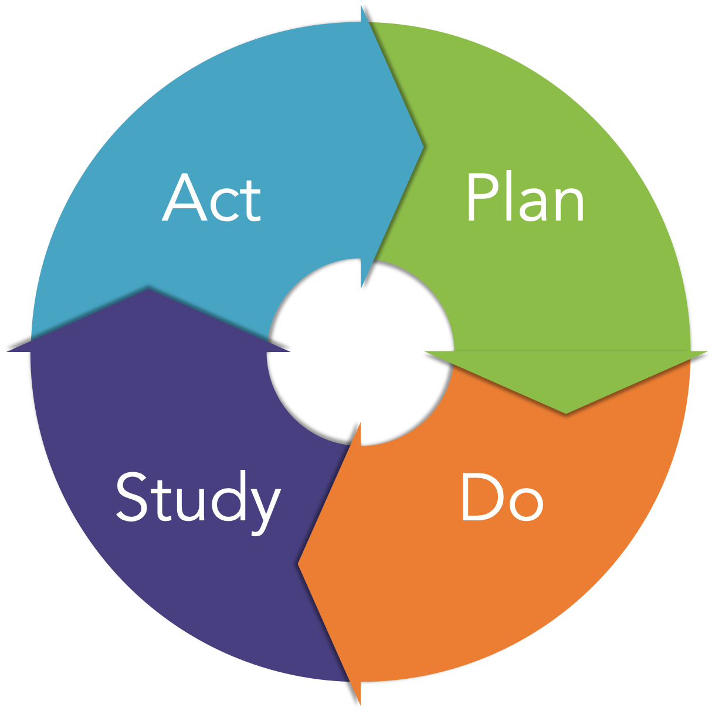
Continuous Improvement = PDSA

Slide 7
Tiny Changes, Remarkable Results
"You do not rise to the level of your goals. You fall to the level of your systems.”
"In order to improve for good, you need to solve problems at the systems level. Fix the inputs and the outputs will fix themselves.”
"Your outcomes are a lagging measure of your habits. Your net worth is a lagging measure of your financial habits. Your weight is a lagging measure of your eating habits. Your knowledge is a lagging measure of your learning habits. Your clutter is a lagging measure of your cleaning habits. You get what you repeat.”

Slide 8
Status Overview and Questions

Slide 9
Every Student Succeeds Act
The "Every Student Succeeds Act" (ESSA) was passed in December 2015 with bipartisan congressional support.
It replaced the No Child Left Behind Act (NCLB) of 2002 and reauthorized the Elementary and Secondary Education Act (ESEA) of 1965.
Despite some key changes in the law, the purpose remains the same: to ensure all students have equitable access to high-quality educational resources and opportunities, and to close educational achievement gaps.
This Photo by Unknown author is licensed under CC BY-SA-NC.

Slide 10
Summative Ratings (1/2)

Slide 11
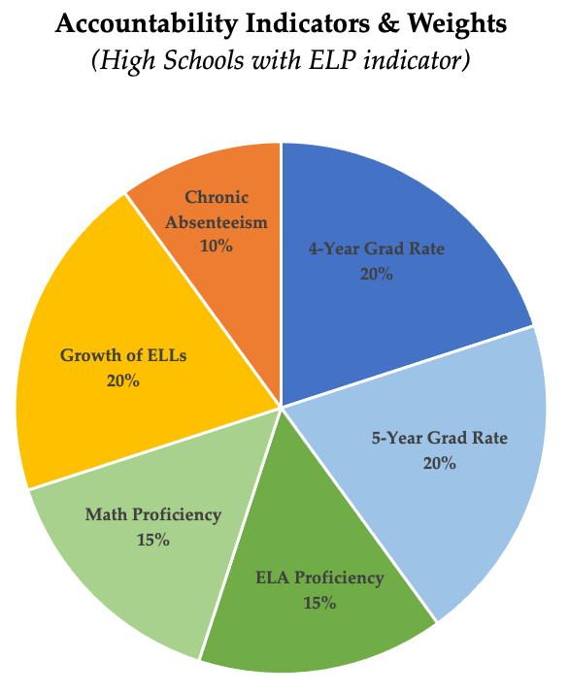
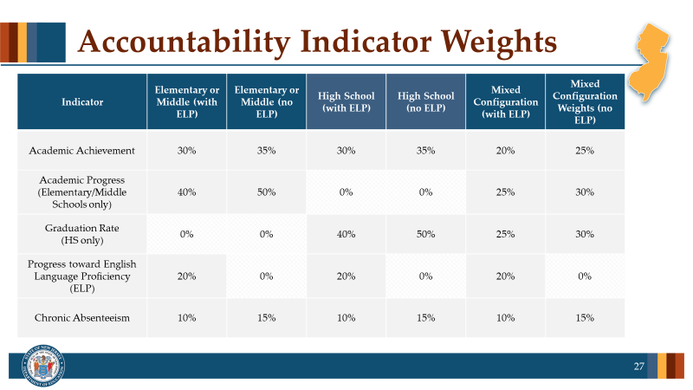
Summative Ratings (2/2)

Slide 12
What Does it Mean to be in "Status"?
New Jersey's school accountability system identifies schools that are in need of comprehensive and targeted support as required by the "Every Student Succeeds Act" (ESSA).
NJDOE will identify schools in the following three federal categories:
Comprehensive Support and Improvement (Overall Low Performing) Schools with a summative score in the bottom 5% of Title I schools.
Comprehensive Support and Improvement (Low Graduation Rate) High schools with a four-year graduation rate of 67% or less
Targeted Support and Improvement (Low Performing Student Group) Schools with one or more student group with a summative score that would be in the bottom 5% of Title I schools

Slide 13
Activity #1: Status Review and Reflection
What were your initial impressions when you learned your school was designated as requiring Comprehensive or Targeted support?
What opportunities have presented themselves or could present themselves because of this identification?

Slide 14
Data 101

Slide 15
What is Data?
Data is information. It can be quantitative, meaning in the form of numbers (counting more specifically), or qualitative, meaning data that describes and characterizes. Both types are descriptive.
For example:
•There are twenty marbles. (“twenty” is quantitative)
•There are twenty blue marbles. (“twenty” is quantitative, “blue” is qualitative).
•Both quantitative and qualitative data can be invaluable resources for school improvement.

Slide 16
Formative vs. Summative Data
Formative data is gleaned from quizzes/tests and other assessments at a regular interval. This data should be used to guide instruction and intervention strategies.
Summative data, like NJSLA and others are given less frequently, only once per year in the case of the latter.
Both formative and summative data give valuable insight to school improvement progress.

Slide 17
Activity #2: What Data is Available? (1/2)
Take a moment to list all the data sets that are available to you.
This Photo by Unknown author is licensed under CC BY-SA.

Slide 18
Activity #2: What Data is Available? (2/2)
Are Students Learning? | Are Students Connected and Engaged? | Are Teachers/Staff Engaged and Productive? | Are Parents and Community Engaged and Supportive?
State Assessment Data/NJSLA | Disciplinary Actions | Teacher Attendance | Parent/Teacher Conference Participation
District Wide Assessments | Attendance | Professional Development Participation | Parent Survey Results
Curriculum Based Classroom Assessments | Truancy | Climate and Culture Survey Results | Parent Volunteers through an established PTSO or PTA
Collaborative Analysis of Student Work | Graduation/Drop Out Rates | Teacher Observation Data
Formative Assessments | Survey Results (SILAS, Panorama SEL survey) | Learning Walks
 |  | Teacher retention rates

Slide 19
Considerations for the Ethical Uses of Data
As leaders you want to model for your staff the importance of using data to make data-based decisions
Use the data to reflect on our current state and acknowledge what is in your locus of control
Use data to track growth and improvement
Use data to refine our instruction/systematic practices
Share results with students and provide them with meaningful feedback that students can use to feed forward and close gaps in learning

Slide 20
Break
We will take a five-minute stretch break.

Slide 21
Data 102

Slide 22
Growth Mindset
“Every data set may not be good, but there is something good in every data set.”
~ Jennifer Hobbs

Slide 23
What are we doing with the data?
District Benchmarks
LinkIt
iReady
Attendance
Discipline
Data Source | Frequency | Area of Focus | Purpose
HM | Quarterly | Math | Summative assessment for content mastery
Attendance report from SIS | Monthly | Attendance/chronic absenteeism | Tiering students for attendance supports
NWEA MAP | Fall, Winter, Spring | ELA | National percentile/grouping

Slide 24
What data do we need?
School Goals
Strategic Planning
Collaborative Partnerships with colleges and other organizations
Measure the effectiveness of instructional programs
Measure the effectiveness of teacher development and growth

Slide 25
What + Why + Action
What – Descriptive statistics (proficiency level, scaled score, student group performance, etc.)
Why – Root cause analysis (focus on locus)
Action – Instructional response + extension/remediation
Example 1 Example 2 Example 3

Slide 26
Implementation and Monitoring Needs

Slide 27
Progress Monitoring + ASP
Monthly inputs
Culture & Climate data (staff and student attendance, in/out-of-school suspensions, etc.)
Quarterly inputs
Benchmark data
Learning Walks
S.M.A.R.T. Goal interim goal status
Ongoing inputs
SLT Meetings
Action step status

Slide 28
Cycle Reviews
What data tells if the interim goal is met/not met? Is the school on track to meet the overall goal?
What shifts in systematic/instructional practice can be highlighted based on the data analysis? What intentional changes in your systems and instruction have occurred due to the data analysis?
What has been the impact of the SIA allocation? What accompanying evidence can be provided to support the hypothesis?
What are your next steps?

Slide 29
Next Steps

Slide 30
What do I do next?
Complete a data inventory with your school and/or district-level colleagues to have a full understanding of the data presently available to make decisions
Choose a protocol or process for data analysis that you're comfortable with moving forward as a leadership team.
Develop a plan for targeted learning walks to ensure that selected strategies are being implemented with fidelity to support student learning.

Slide 31
Presenter Contact Information
Jennifer Hobbs Data Specialist, RST-North (973) 902-6969 jennifer.hobbs@doe.nj.gov
Reina Irizarry-Clark Data Specialist, RST-Central (609) 658-0366 reina.irizarry-clark@doe.nj.gov
Lindsay Wilhelmi-Guay Data Specialist, RST-South (856) 301-0087
lindsay.wilhelmi-guay@doe.nj.gov
Dr. Chimaobi Amutah Statewide Data Manager State Transformation Specialist (609) 468-7349 chimaobi.amutah@doe.nj.gov
Matthew Norcross Data Analyst (856) 372-0238 matthew.norcross@doe.nj.gov

Slide 32
Questions

Slide 33
Thank You!
New Jersey Department of Education: nj.gov/education
Office of Comprehensive Support: OCS@doe.nj.gov
ASP Technical Support: ASP@doe.nj.gov
Follow Us!
Facebook: @njdeptofed
Twitter: @NewJerseyDOE
Instagram: @NewJerseyDoe

